Slide 1
Duality
K-Maps can be used also to create a minimal POS form:
Collects 0 instead of 1
Each square represents a maxterm
Each covering represents a SUM

Slide 2
4-Input Maxterms
A+B+C+D A+B’+C+D A’+B’+C+D A’+B+C+D
A+B+C+D’ A+B’+C+D’ A’+B’+C+D’ A’+B+C+D’
A+B+C’+D’ A+B’+C’+D’ A’+B’+C’+D’ A’+B+C’+D’
A+B+C’+D A+B’+C’+D A’+B’+C’+D A’+B+C’+D

Slide 3
4-Input K-Map (Do it again)
1 0 0 1
0 1 0 1
1 1 0 0
1 1 0 1
Y=(A’+B’)(B’+C+D)(A’+C’+D’)(A+B+C+D’)

Slide 4
K-Maps with Don’t Cares (Do it again)
1 0 X 1
0 X X 1
1 1 X X
1 1 X X
Y= (B’+C)(A+C+D’)

Slide 5
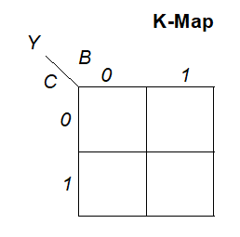
Use K-Maps to see theorems
Number | Theorem | Name
T9 | B• (B+C) = B | Covering
0 1
0 1

Slide 6
Use K-Maps to see theorems
Number | Theorem | Name
T10 | (B•C) + (B•C) = B | Combining
0 1
0 1

Slide 7
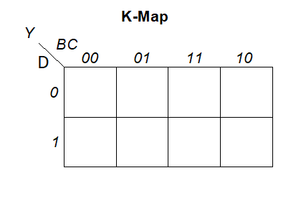
Use K-Maps to see theorems
Number | Theorem | Name
T11 | (B•C) + (B•D) + (C•D) = (B•C) + (B•D) | Consensus
0 0 1 0
1 1 1 0

Slide 8
Quine–McCluskey algorithm
The Quine–McCluskey algorithm (QMC), also known as the method of prime implicants, is a method used for minimization of Boolean functions with n variables
The Quine–McCluskey algorithm is functionally identical to Karnaugh mapping, but the tabular form makes it more efficient.

Slide 9
MULTILEVEL COMBINATIONAL LOGIC
Logic in SOP/POS form is called two-level logic.
Designers often build circuits with more than two levels of logic gates.
These multilevel combinational circuits may use less hardware than their two-level counterparts.
Bubble pushing is especially helpful in analyzing and designing multilevel circuits.

Slide 10
MULTILEVEL COMBINATIONAL LOGIC
For example, consider building a three-input XOR using the two-level techniques we have studied.

Slide 11
MULTILEVEL COMBINATIONAL LOGIC
3-input XOR

Slide 12
MULTILEVEL COMBINATIONAL LOGIC

Slide 13
MULTILEVEL COMBINATIONAL LOGIC
Domande:
quante porte AND servono per fare uno XOR ad 8 ingressi utilizzando una rete AND/OR a 2 livelli?
Quanti ingressi hanno le AND
Quanti ingressi ha l’OR che raccoglie le uscite degli AND?

Slide 14
Combinational Building Blocks
Multiplexers
Decoders

Slide 15
Multiplexer (Mux)
Selects between one of N inputs to connect to output
log₂N-bit select input – control input
Example: 2:1 Mux
Y = SD₀ +SD₁

Slide 16
Multiplexer Implementations
Logic gates
Sum-of-products form
Tristates
For an N-input mux, use N tristates
Turn on exactly one to select the appropriate input

Slide 17

Multiplexer a 4 ingressi
I multiplexer a 4 ingressi possono essere realizzati a partire da quelli a 2 ingressi:
S₀
D₀
S₁ S₀ Y
0 0 D₀
0 1 D₁
1 0 D₂
1 1 D₃
S₁
D₁
S₀
Y
D₂
D₃

Slide 18
MUX
Domande:
quante porte AND servono per fare un MUX ad 8 ingressi utilizzando una rete AND/OR a 2 livelli?
Quanti ingressi hanno le AND ?
Quanti ingressi ha l’OR che raccoglie le uscite degli AND?

